Slide 1
Orientation 2019
AMES
Notes:
Bring handout for AMES resources

Slide 2

Academic Advising Center
Academic Advising for Exploring Students
General Education
Academic Policies
Campus Resources
Notes:
Jason
Who are we and what we help students with in our office.

Slide 3

What is an Academic Advisor?
More than scheduling classes
Partnership
Advocate
Campus resources
How to find answers for yourself
WILL NOT make decisions for you
Notes:
Jason
We’re from the UU, but if you are planning to attend any college/university, it is important to know what an advisor is & helps with.
More than scheduling classes, but helps build schedules
Partnership. Mentor. Help discuss your goals and brainstorm ways to achieve them.
Advocate
Help understand bureaucracy of a larger system
Campus resources
How to find answers for yourself
WILL NOT make decisions for you.
High school counselor vs advisor

Slide 4

What is non-matriculated?
Allowed to take classes without being admitted
Not officially admitted
Not seeking a degree
Grades are monitored
Notes:
JAson

Slide 5
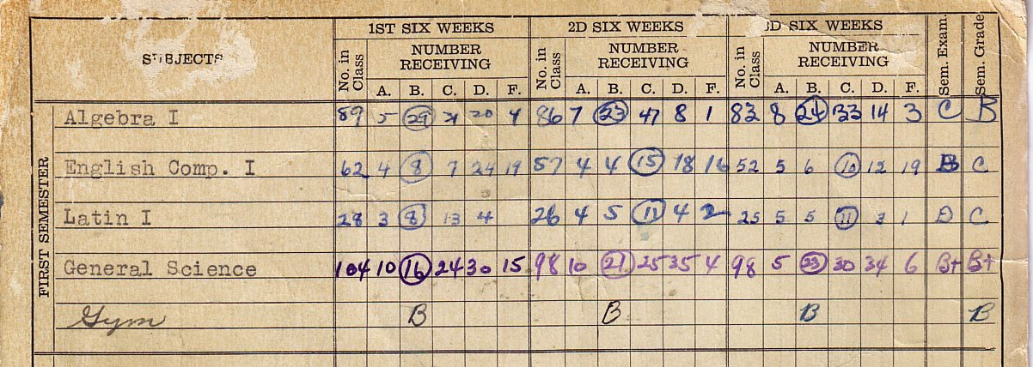
What does it mean to have a University Transcript?
Academic History & it follows you
Notes:
JAsonOpportunity
--Cost alone
History
--only shows your UU grades.
--Clearinghouse
Scholarships/Financial Aid

Slide 6

What implications does your University Transcript have?
  Financial Aid and Scholarships
  financialaid.utah.eduhttp://financialaid.utah.edu/policies/satisfactory-academic-progress/index
    Minimum 2.o cumulative gpa
    67% completion rate
  Applying to colleges
  and majors
Notes:
Jason
Minimum cum gpa of 2.0: About a C average. Many majors require higher than a 2.0 though to declare and join the major.
67% Completion Rate: 67% of college grades have to be passed. Students who have Financial Aid can’t have a lot of E’s, incomplete grades, withdrawing from classes, and repeating classes.
The website has a scholarships database and more information about all types of financial aid.

Slide 7

What is a Pre-requisite?
A class you need to have before registering for another course.
Minimum grade (often C)
Example:
Math
Notes:
Jason
Department decides which course you need to be successful in the next one.

Slide 8



Anatomy of a syllabus
Read it
Make note of the deadlines
  Tests, papers, assignments, etc
Grading structure
Ask questions early
Instructor contact information
Notes:
Jake
You will receive a syllabus for each course. It will communicates course information and defines the instructor’s expectations of you and your responsibilities.
Add assignment deadlines, mid-terms, quizzes, etc. from all syllabi into 1 calendar.
Grading structure. Some courses may weigh quizzes heavier than assignments.
Ask Questions – if something is not clear – clarify with the instructor .
How to contact instructor if there are questions

Slide 9

How to withdraw from a class?
Dropping: You can drop a course without a W posted on the transcript by 8th business day of a semester.
Withdrawing: Withdraw from a course is allowed up until the deadline and a W will be posted on your record.
After the withdrawal deadline, petition with documentation of non-academic emergency is required for consideration.
All adds, drops, withdrawals, and petitions go through Liz Taylor.
Withdraw deadline:
Fall October 16 Spring March 4f
CANNOT REPEAT AT AMES) term
Notes:
Jake
Give examples
You might drop a course if after the first few days of class you realize the course material is too challenging and success is very unlikely.
You might withdraw from a course if the drop deadline has passed and you realize it is impossible to earn a passing grade.

Slide 10


Academic Standing
If cumulative gpa 2.0 or above = Good Standing
If cumulative gpa below 2.0 = Hold / Warning
Notes:
Jake
2.0 – term & cumulative/overall = Good Standing
Below 2.0 – term & cumulative/overall = Probationary standing (Warning) & hold
No longer can pursue classes after on warning.
C- is 1.7
C’s don’t get degrees

Slide 11
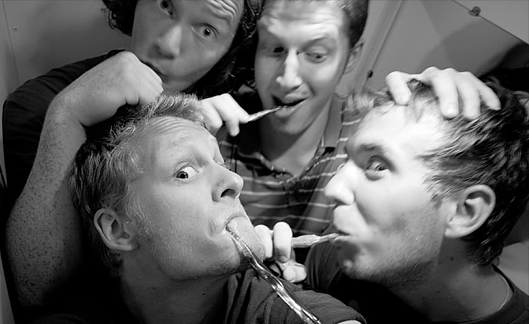
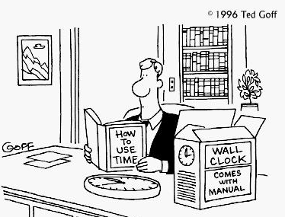
Time Management
College classes require different study habits than high school classes
2 hrs of study for every 1 hr in class; maybe more (i.e. CHEM)
Notes:
Jake
Some classes can be even longer 2 hours rule.
We hear freshman always say how they did not have to really study in high school and that college is way more challenging.
Set amount of time each week. – 168
Semester Calendar
Toothbrush story
Get & use a calendar
Write down everything
Schedule time to relax
If a particular study method isn’t working for you…Keep trying new methods
Allow for flexibility
Plan ahead
Plan for the unexpected
Schedule reward (fro-yo)

Slide 12
U of U Resources
E-Tutoring: online.utah.edu
Math Tutoring: math.utah.edu/lectures
Undergraduate Bulletin: undergradbulletin.utah.edu
General Catalog: catalog.utah.edu
Student Handbook: registrar.utah.edu/handbook
Facts About the U of U: utah.edu/about
Academic Advising Center – Advising!
Notes:
Jake
Help with classes should always start with a conversation with your professor.

Slide 13
Questions?
Schedule Appointments & Quick Questions: 801.581.8146

Slide 14

Math Paths
STEM/Business/Education
Math 1010 – Math 1050 – Math 1060 – Math 1210 – Math 1220
Humanities/Fine Arts/Health/Social & Behavioral Science
Math 1030
Math 1040, Math 1070

Slide 15

MATH: 1030 vs. 1050
How do you choose?
MATH 1050 is a prerequisite for:
MATH 1060: Trigonometry
MATH 1210 Calculus
CHEM 1210: General Chemistry I

Slide 16

What can you do now?!
Take some tough classes (CE, AP)
Get a certification (CNA, phlebotomy, pharmacy tech, etc)
Figure out how to be a good
student. Learn good study habits
Learn how to manage your time
Enjoy being in high school
Notes:
Choosing wisely can prepare you for many directions

Slide 17
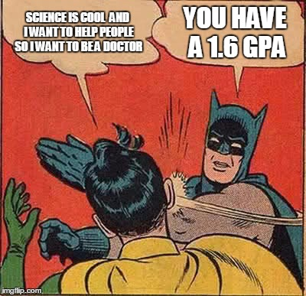
GPA
Concurrent Enrollment Classes: take them seriously
AP/IB Courses
High School GPA vs. College GPA
Notes:
Choosing wisely can prepare you for many directions

